Slide 1
Using Bayesian Optimization in Pose Graphs Based SLAM 7th July
Zuxun Wang

Slide 2
Progress Since Last Meeting
Linear example -> reduce measurement edges
In the first 20 timesteps, have a position observation every time step. Beyond timestep 20, insert a position measurement into the graph every 2 timesteps
Generate the Consistency Measurement Metric graph for GPS system
Omega values from 0.1 -> 1.9, with stride 0.1
Test for both proposition 3 and 4

Slide 3
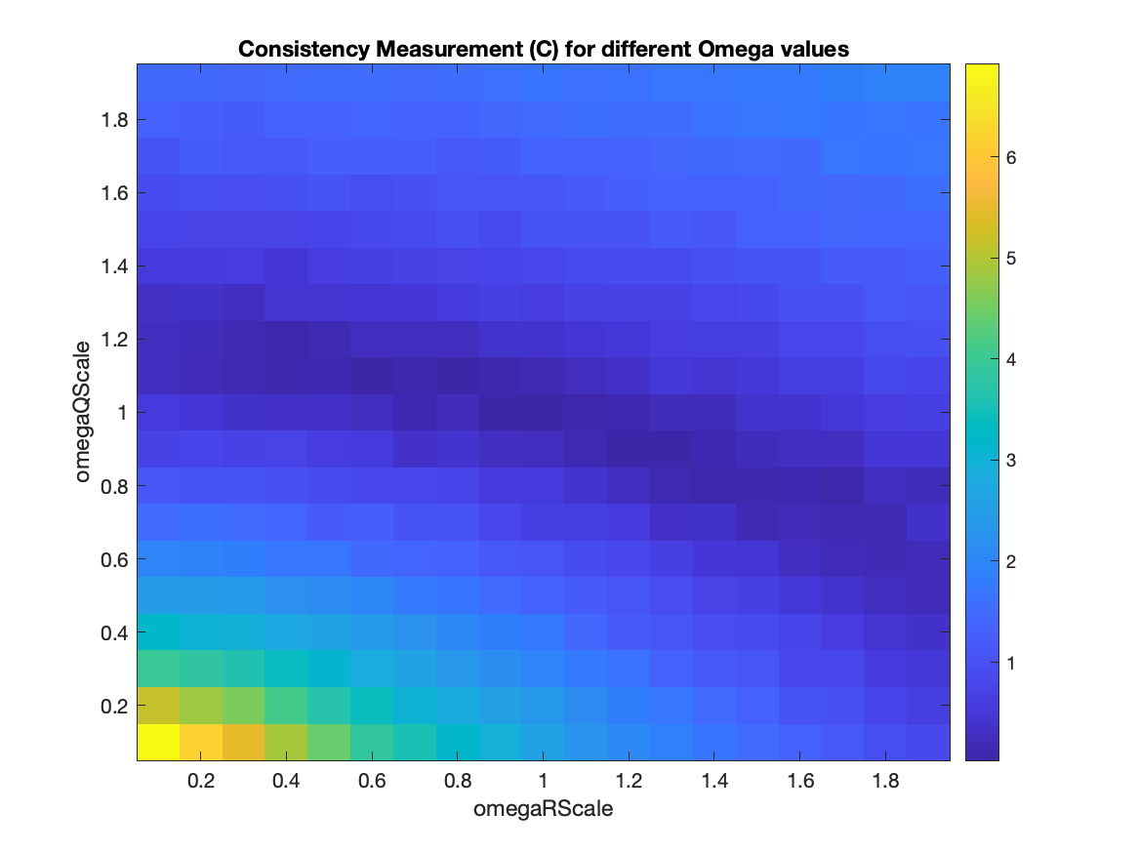
Consistency Measurement Metric (Disable proposition 4)
Total number of timestep: 100
Number of episodes: 1000
numObs: 20
obsPeriod: 2

Slide 4
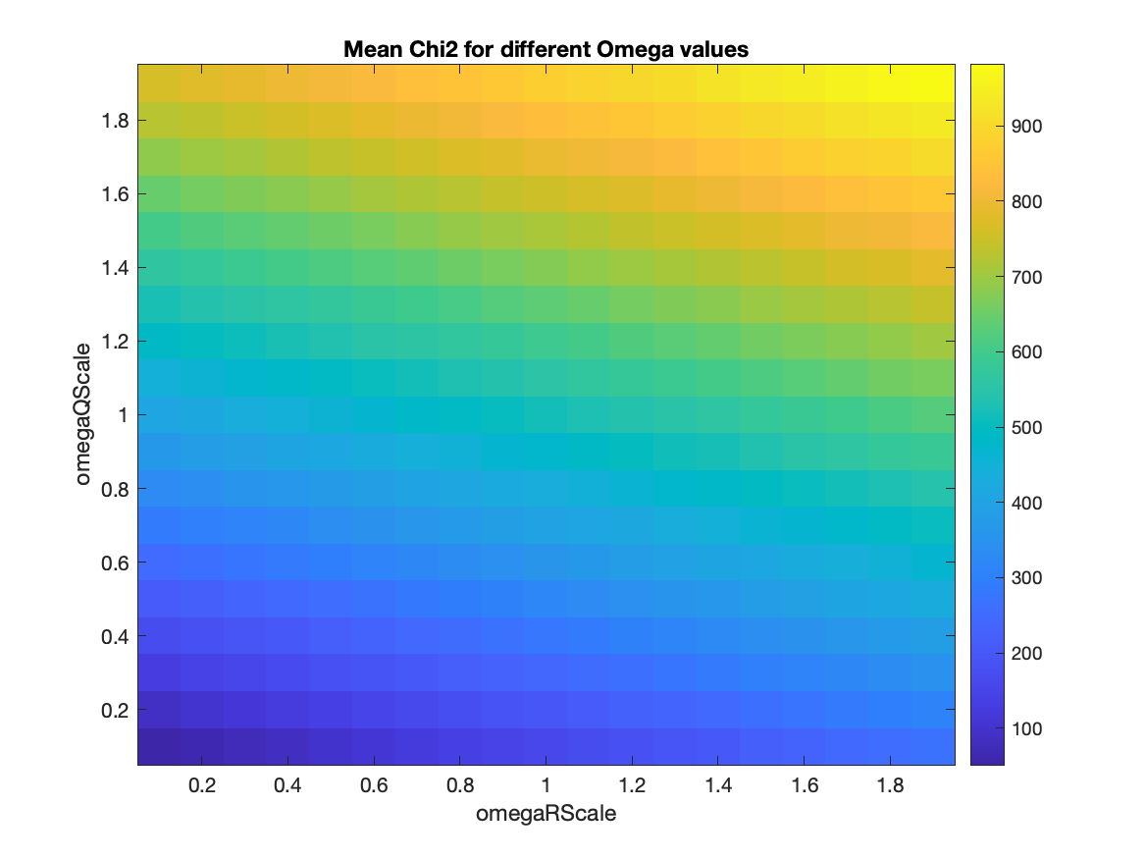
Mean of chi2 (Disable proposition 4)
Total number of timestep: 100
Number of episodes: 1000
numObs: 20
obsPeriod: 2

Slide 5
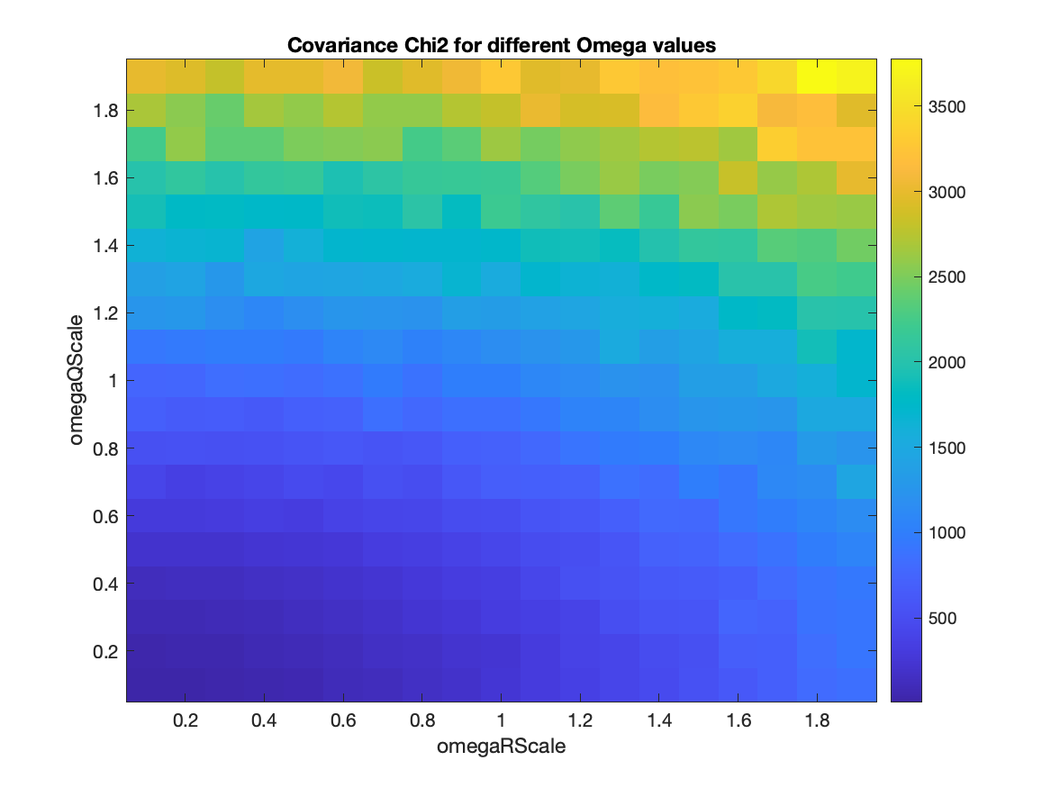
Chi2 covariance (Disable proposition 4)
Total number of timestep: 100
Number of episodes: 1000
numObs: 20
obsPeriod: 2

Slide 6
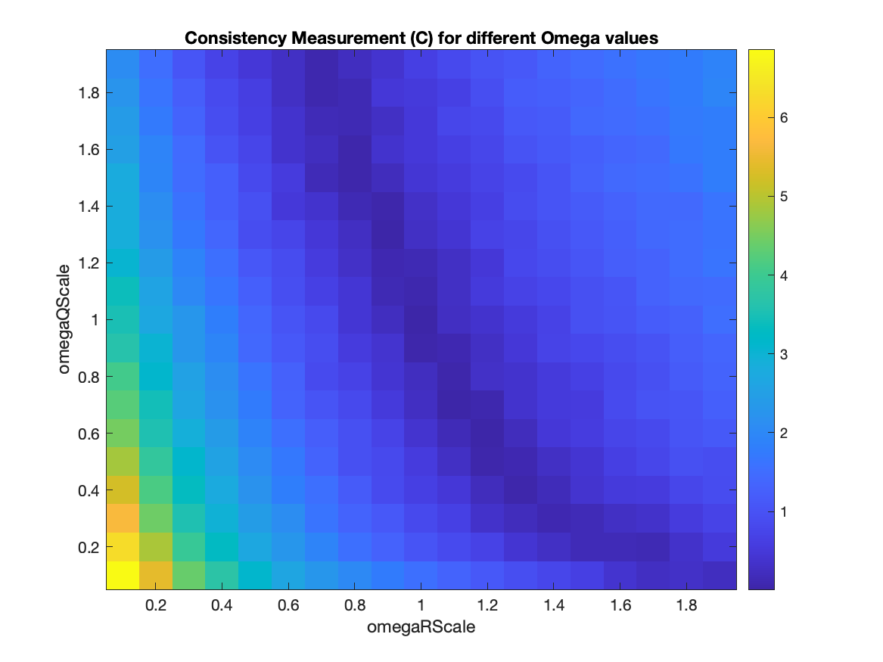
Consistency Measurement Metric (Enable proposition 4)
Total number of timestep: 100
Number of episodes: 1000
numObs: 20
obsPeriod: 2

Slide 7
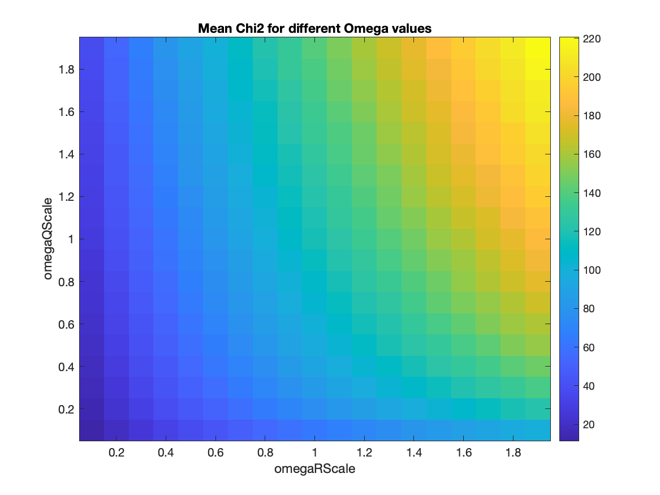
Mean of chi2 (Enable proposition 4)
Total number of timestep: 100
Number of episodes: 1000
numObs: 20
obsPeriod: 2

Slide 8
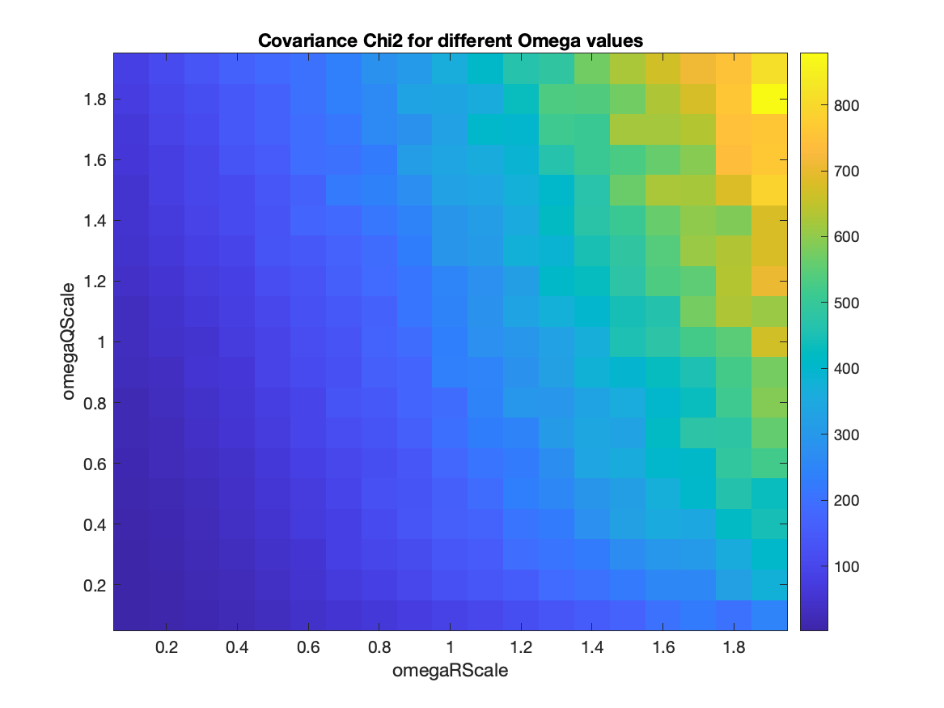
Chi2 covariance (Enable proposition 4)
Total number of timestep: 100
Number of episodes: 1000
numObs: 20
obsPeriod: 2

Slide 9
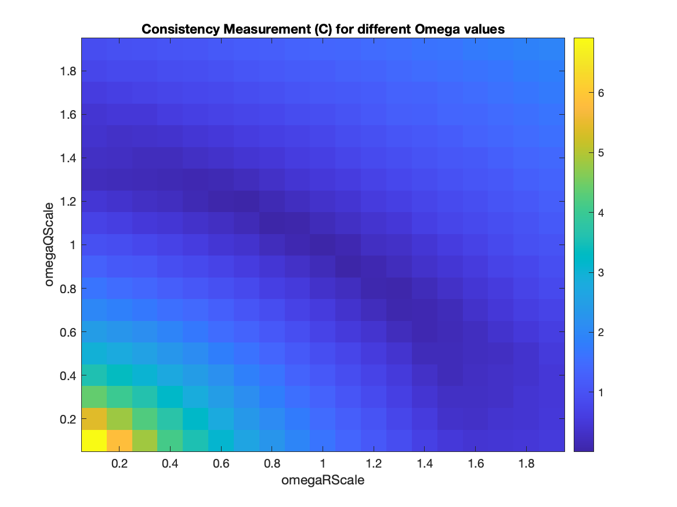
Consistency Measurement Metric (GPS-Disable proposition 4)
Total number of timestep: 40
Number of episodes: 10000
numObs: /
obsPeriod: /

Slide 10
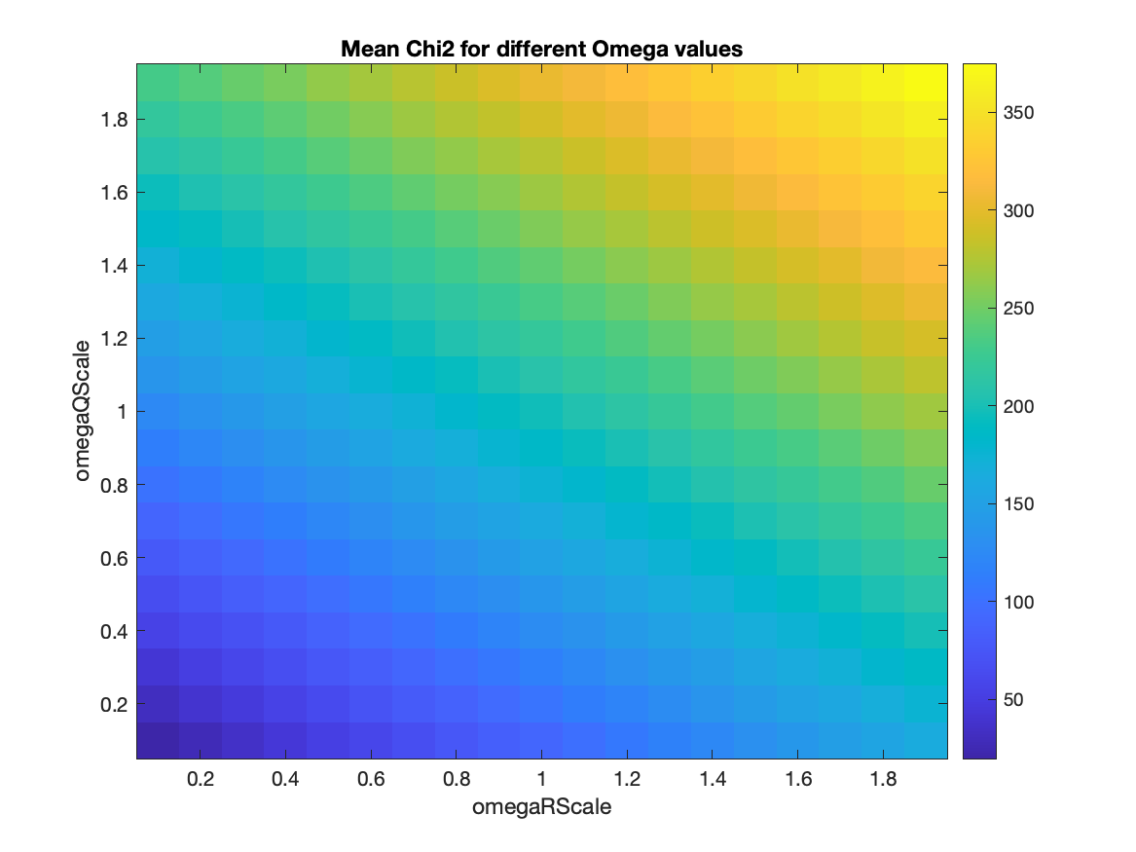
Mean of chi2 (Disable proposition 4)
Total number of timestep: 40
Number of episodes: 10000
numObs: /
obsPeriod: /

Slide 11
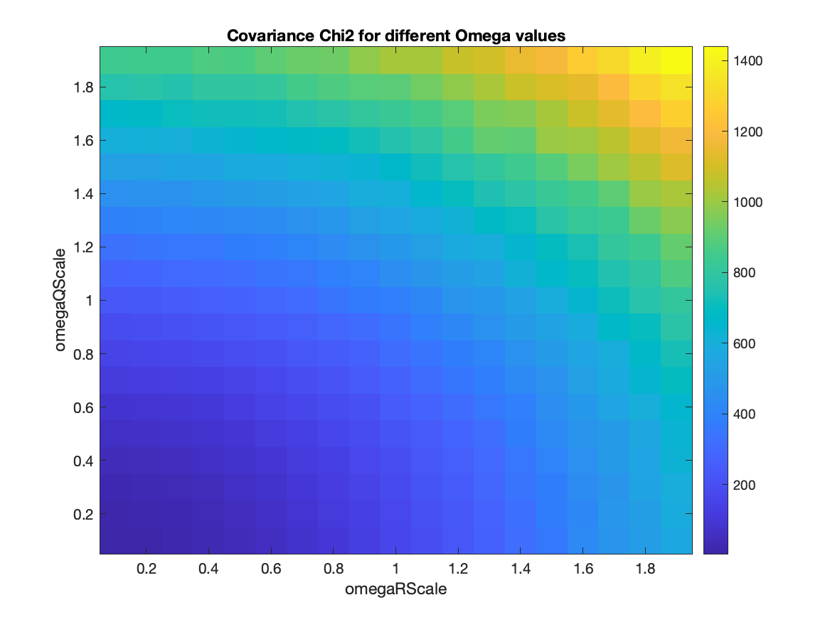
Chi2 covariance (Disable proposition 4)
Total number of timestep: 40
Number of episodes: 10000
numObs: /
obsPeriod: /

Slide 12
Problems / Issues

Slide 13
Planned Activities
Surf plot for the consistency metric values
Working on the VehicleTrackingExample.m
Graphs for nonlinear systems
Omega ranges 0.1 to 1.9?
Bayes opt
Writing report
Math/notation describe the problem
(Simon’s good practice) 2 – 3 hours/day writing essay
Coding 7 – 8 hrs/day
Think about Evaluation part

